Slide 1


22CAC09
FULL STACK DEVELOPMENT
UNIT-I
HTML 5.0

Slide 2
General Structure of HTML
<html>
<head>
<title>
Title of the page
</title>
</head>
<body>
Content of the page
</body>
</html>

Slide 3
What is HTML?
HTML stands for Hyper Text Markup Language.
HTML is the standard markup language for creating Web pages.
HTML elements are the building blocks of HTML pages.
The HTML element is everything from the start tag to the end tag:
<h1>My First Heading</h1>
HTML elements are represented by tags.
Browsers do not display the HTML tags, but use them to render the content of the page.

Slide 4
HTML
The <!DOCTYPE html> declaration defines this document to be HTML5.
The <html> element is the root element of an HTML page.
The <head> element contains meta information about the document.
The <title> element specifies a title for the document.
The <body> element contains the visible page content.
The <h1> element defines a large heading.
The <p> element defines a paragraph. .html / .htm

Slide 5
HTML Tags
HTML tags are element names surrounded by angle brackets:
<tagname>content goes here...</tagname>
HTML tags normally come in pairs like <p> and </p>
The first tag in a pair is the start tag, the second tag is the end tag
The end tag is written like the start tag, but with a forward slash inserted before the tag name

Slide 6
STURUCTURAL TAGS
<HTML>
These tags enclose the entire Web page document.
</HTML>
<HEAD>
These tags enclose the Head part of the document
</HEAD>
<TITLE> These tags enclose the title of the document. This text appears in the title bar in the browser and on the bookmark list if someone bookmarks your web page.
</TITLE>

Slide 7
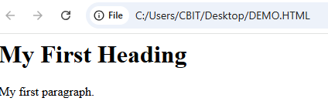
A SIMPLE HTML Document
<!DOCTYPE html> <html> <head> <title>First Program</title> </head> <body> <h1>My First Heading</h1> <p>My first paragraph.</p> </body> </html>
Save it as DEMO.html

Slide 8
HTML Element Syntax
HTML Elements represent semantics, or meaning.
For example, The title element represents the title of the document.
Most HTML elements are written with a start tag and an end tag with the content in between.
<tagname>Content goes here...</tagname>
Elements can also contain attributes that define additional properties of an element

Slide 9
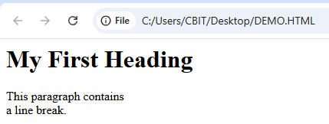
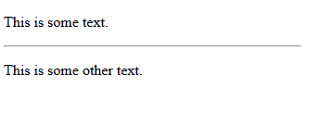
Empty HTML Elements
Empty elements (also called self-closing or void elements) are not container tags — that means, you can not write
<hr>some content</hr>
Or <br>some content</br>.
A typical example of an empty element, is the <br> element, which represents a line break.
<p>This paragraph contains <br> a line break.</p>
hr stands for horizantal rule ,it is used to give thematic break Example <!DOCTYPE html>
<html>
<body>
<p>This is some text./p>
<hr style="width:50%;text-align:left;margin-left:0">
<p>This is some other text.</p>
</body>
</html>

Slide 10
HTML5 Tags
HTML5 tags are not case sensitive:
<P> means the same as <p>.
<!DOCTYPE html>
<head>
<title>welcome</title>
</head>
<body>
<p>welcome</P>
</body>
</html>

Slide 11
HTML Comment Tags
You can add comments to your HTML source by using the following syntax:
<!– Write your comments here -->
With comments you can place notifications and reminders in your HTML.

Slide 12
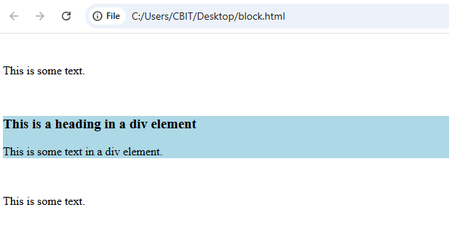
Block-Level Elements
Block-level elements are those elements that are formatted visually as blocks with a line break before and after the element.
<!DOCTYPE html>
<html>
<body>
<p>This is some text.</p>
<div style="background-color:lightblue">
<h3>This is a heading in a div element</h3>
<p>This is some text in a div element.</p>
</div>
<p>This is some text.</p>
</body>
</html>

Slide 13
div tag width and height styles
% Percentage of the parent element width: 50%;
vw Viewport width (1vw = 1% of browser width) width: 100vw;
vh Viewport height (1vh = 1% of browser height) height: 100vh;
em Relative to the parent element's font size font-size: 2em;
rem Relative to the root (<html>) font size font-size: 1.5rem;
cm Centimeters width: 10cm;
mm Millimeters width: 50mm;
in Inches width: 2in;
pt Points (1 pt = 1/72 inch) font-size: 12pt;
pc Picas (1 pc = 12 pt) margin: 2pc;
vmin Smaller of viewport width or height width: 50vmin;
vmax Larger of viewport width or height width: 50vmax;
auto Browser automatically calculates the size margin: auto;

Slide 14
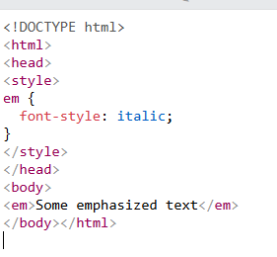

Inline-Level Elements & Headings
Inline-level elements are those elements of the source document that do not form new blocks of content; the content is distributed in lines.
For example, emphasized pieces of text within a paragraph (<em>), strong element (<strong>) etc.
HTML headings are defined with the <h1> to <h6> tags.
<h1> defines the most important heading.
<h6> defines the least important heading.

Slide 15
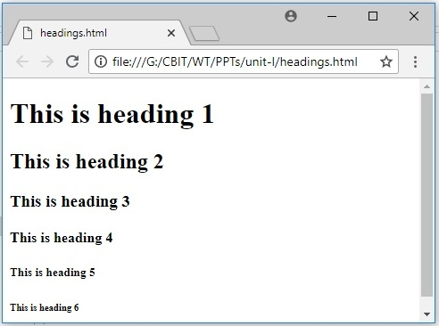
HTML Headings
<!DOCTYPE html>
<html>
<body>
<h1>This is heading 1</h1>
<h2>This is heading 2</h2>
<h3>This is heading 3</h3>
<h4>This is heading 4</h4>
<h5>This is heading 5</h5>
<h6>This is heading 6</h6>
</body>
</html>

Slide 16
HTML Attributes
All HTML elements can have attributes
Attributes provide additional information about an element
Attributes are always specified in the start tag
Attributes usually come in name/value pairs like: name="value"

Slide 17
The Style Attribute
The style attribute is used to specify the styling of an element, like color, font, size etc.
<!DOCTYPE html>
<html>
<body>
<p style="color:red">I am a paragraph.</p>
<p>Use the style attribute to control an element's layout.</p>
</body>
</html>
I am a paragraph.

Slide 18
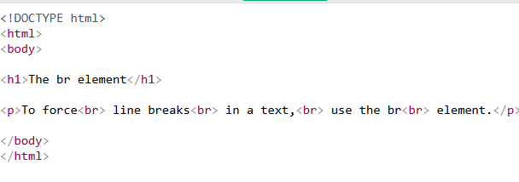
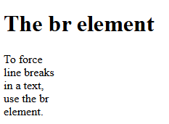
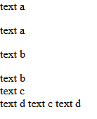
BREAKING LINES AND PARAGRAPHS
<P> text </P>
Paragraph tag
Most browsers render (process) this with blank lines between each paragraph.
<br>
Line break tag
Used when the webmaster wants a carriage return but doesn't want a blank line to follow.
Example: text a
<p>text a</p>
<p>text b</p> text b
<br>text c
<br>text d text c
text d

Slide 19
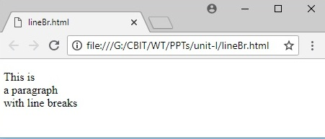
USAGE OF <br>
<!DOCTYPE html>
<html>
<body>
<p>This is<br>a paragraph<br>with line breaks</p>
</body>
</html>

Slide 20
Text Formatting Tags
Tag Result
<I> Italics </I> Italics
<B> Bold </B> Bold
<PRE> Preformatted Text </PRE> Preformatted Text
<STRONG> Strong </STRONG> Strong
<ADDRESS> Address </ADDRESS> Address
<CITE> Citations </CITE> Citations
<CODE> Source Code </CODE> Source Code

Slide 21
HTML Text Formatting Tags
Tag Description
<b> Defines bold text.
<del> Defines deleted text.
<em> Defines emphasized text.
<i> Defines italic text.
<ins> Defines inserted text.
<mark> Defines marked/highlighted text.
<small> Defines small text.
<strong> Defines strong text.
<sub> Defines subscripted text.
<sup> Defines superscripted text.

Slide 22
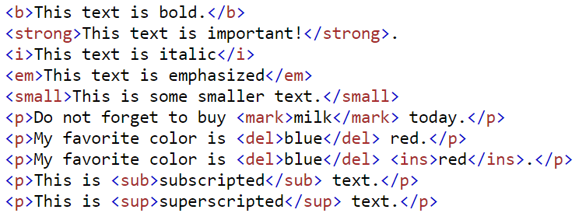
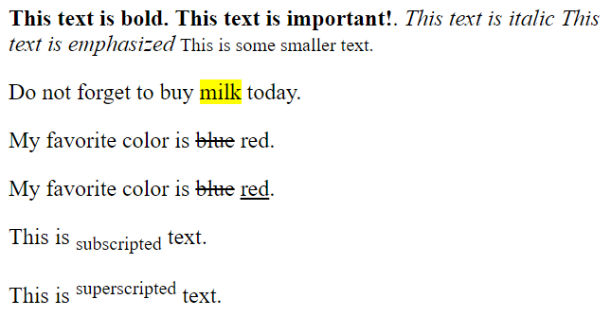
HTML Text Formatting Tags

Slide 23
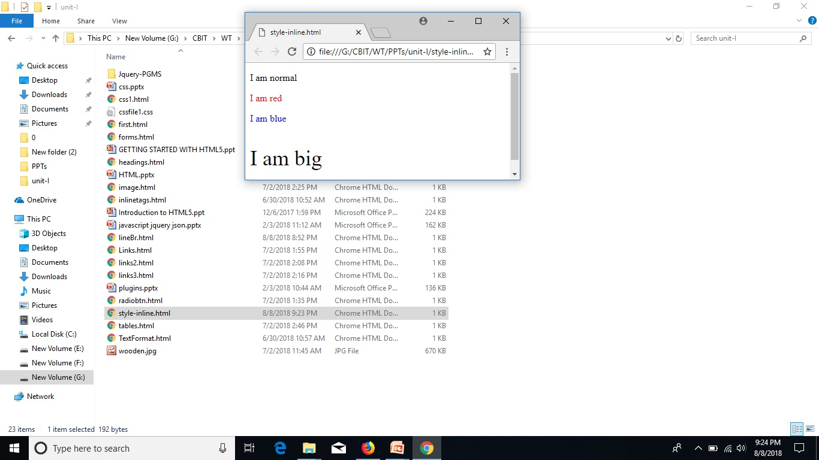
HTML Styles (Inline)
<!DOCTYPE html>
<html>
<body>
<p>I am normal</p>
<p style="color:red;">I am red</p>
<p style="color:blue;">I am blue</p>
<p style="font-size:36px;">I am big</p>
</body>
</html>

Slide 24
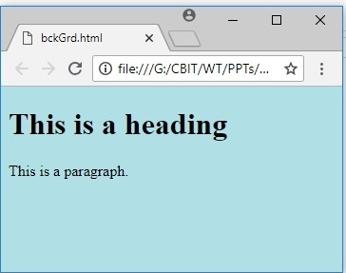
HTML Background Color
<!DOCTYPE html>
<html>
<body style="background-color:powderblue;">
<h1>This is a heading</h1>
<p>This is a paragraph.</p>
</body>
</html>

Slide 25
FONT MODIFICATIONS
Web creators can also change the way text looks by using the <FONT> tag.
Changes size of the font: SIZE="number" 1=smallest, 7 = largest <FONT SIZE="7">Big</FONT> <FONT SIZE="1">Small</FONT>
Big Small
Changes Text Color: COLOR="color-name"
<FONT COLOR="red">This is red</FONT> This is red
Changes Font: FACE="font-name"
<FONT FACE="verdana">This is the verdana font;</FONT>
<FONT FACE="chicago">This is the chicago font.</FONT>
This is the verdana font;
This is chicago font.

Slide 26
HTML LINKS
HTML links are hyperlinks.
You can click on a link and jump to another document.
When you move the mouse over a link, the mouse arrow will turn into a little hand.
Syntax:
<a href="url">link text</a>

Slide 27
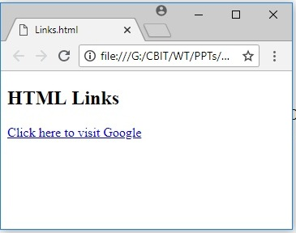
HTML LINKS
<!DOCTYPE html>
<html>
<body>
<h2>HTML Links</h2>
<p>
<a href="https://www.google.com/">Click here to visit Google </a> </p>
</body>
</html>

Slide 28
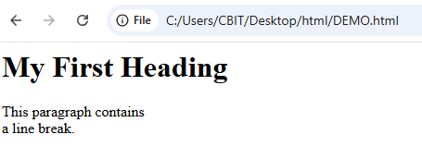
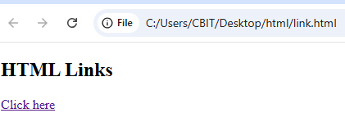
Navigation in HTML
<!DOCTYPE html>
<html>
body>
<h2>HTML Links</h2> <p>
<a href=“DEMO.html”>Click here </a>
</p>
</body>
</html>

Slide 29
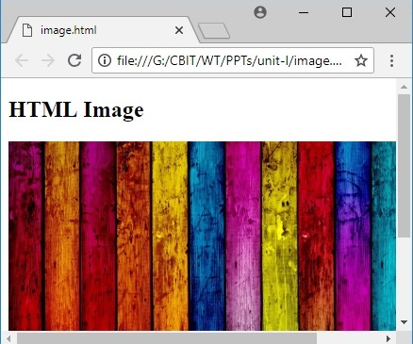
HTML IMAGES
<!DOCTYPE html>
<html>
<body>
<h2>HTML Image</h2>
<img src=“wooden.jpg" alt=“Wooden" width="500" height="333">
</body>
</html>

Slide 30
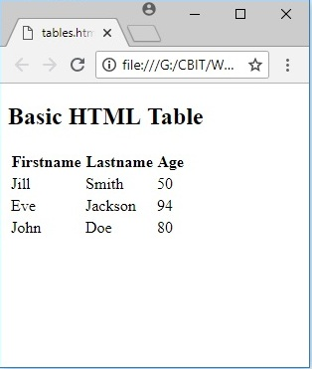
<!DOCTYPE html>
<html>
<body>
<h2>Basic HTML Table</h2>
<table>
<tr>
<th>Firstname</th>
<th>Lastname</th>
<th>Age</th>
</tr>
<tr>
<td>Jill</td>
<td>Smith</td>
<td>50</td>
</tr>
<tr>
<td>Eve</td>
<td>Jackson</td>
<td>94</td>
</tr>
<tr>
<td>John</td>
<td>Doe</td>
<td>80</td>
</tr>
</table>
</body>
</html>

Slide 31
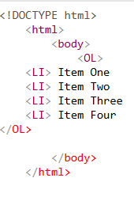
Lists -- Ordered Lists
Ordered List Attributes:
Ordered (Numbered) Lists:
<OL>
<LI> Item One
<LI> Item Two
<LI> Item Three
<LI> Item Four
</OL>
1. Item One
2. Item Two
3. Item Three
4. Item Four
type="i/I/a/A/1" (default)
i = i. Item One I =I. Item One a =a. Item One A =A. Item One 1 =1.Item One
ii. Item Two II. Item Two b. Item Two B. Item Two 2. Item Two
iii. Item Three III. Item Three c. Item Three C. Item Three 3. Item Three
iv. Item Four IV. Item Four d. Item Four D. Item Four 4. Item Four

Slide 32
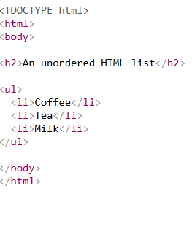
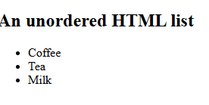
Lists -- Unordered Lists
Unordered lists:
<UL>
<LI>Item One
<LI>Item Two
<LI>Item Three
<LI>Item Four
</UL>
Item One
Item Two
Item Three
Item Four
Unordered List Attributes:
type="disc/circle/square"
Disc (default) ⚪ Circle ■ Square

Slide 33
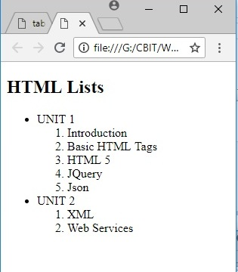
HTML Lists
<!DOCTYPE html>
<html>
<body>
<h2>HTML Lists</h2>
<ul>
<li>UNIT 1</li>
<ol>
<li>Introduction</li>
<li>Basic HTML Tags</li>
<li>HTML 5</li>
<li>JQuery</li>
<li>Json </li>
</ol>
<li>UNIT 2</li>
<ol>
<li>XML</li>
<li>Web Services</li>
</ol>
</ul>
</body>
</html>

Slide 34
HTML 5 Elements
Form controls
Layout Management
Graphics
Media
Span and div tags

Slide 35
HTML Form Controls
Text input(one line or multiple lines)
Checkboxes
Radio buttons
Dropdowns
Submit and reset buttons

Slide 36

<input> Tag
Form elements use the <input> tag, with a type="..." attributes to tell which kind of element it is.
Input tag attributes
Type - specifies type of the input control
Name – name of the control
Textfield
<form>
Rollno<input type="text" name="rollno" size="20” maxsize=“10”/><br/>
stuname<input type="text" name="studentname" size="30“/><br/>
</form>

Slide 37


HTML Form Controls
Checkbox
<form> <input type=“checkbox” name=“branch” value=“cse” checked=“checked”/>CSE<br/>
<input type=“checkbox” name=“branch” value=“it”/>IT<br/>
</form>
Radio buttons
<input type="radio" name="radiobutton" value="1“/>male<br/> <input type="radio" name="radiobutton" value=“2”checked=“checked”/> female

Slide 38
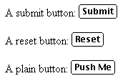
HTML Form Controls-Buttons
A submit button: <input type="submit" name="Submit" value="Submit">
A reset button: <input type="reset" name="Submit2" value="Reset">
A plain button: <input type="button" name="Submit3" value="Push Me">

Slide 39
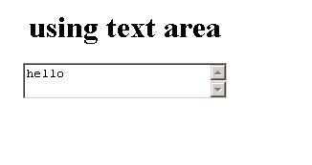
HTML Form Controls- Textarea
Textarea: To insert a text area we use the tag <textarea>
Syntax:
<textarea name=“string” rows=“n” cols=“n” > … </textarea>
<form>
<center>
<h1>using text area</h1>
<textarea name="textarea" rows="2" cols="24">hello</textarea>
</center>
</form>

Slide 40

HTML Form Controls- Drop Down List
<Select> : To create a drop down list we use <select> tag
Syntax:
<select name=“string” > …… </select>
<option> : To insert the values in the dropdown list we use the tag
Syntax:
<option value= “string” [selected]> …. </option>
<select name=“countries”>
<option value=“1” selected=“selected”> India</option>
<option value=“2”> Srilanka</option>
<option value=“3”> Bangladesh</option>
</select>

Slide 41
NEW INPUT TYPES
html>
<body>
<form action="">
Birthday: <input type="date" name="bday"><br><br>
Select your favorite color:
<input type="color" name="favcolor" value="#ff0000">
<br><br>
E-mail:<input type="email" name="email">
<br><br>
Quantity (between 1 and 5):
<input type="number" name="quantity" min="1" max="5">
<input type="submit">
<br><br>
</form>
</body>
</html>

Slide 42
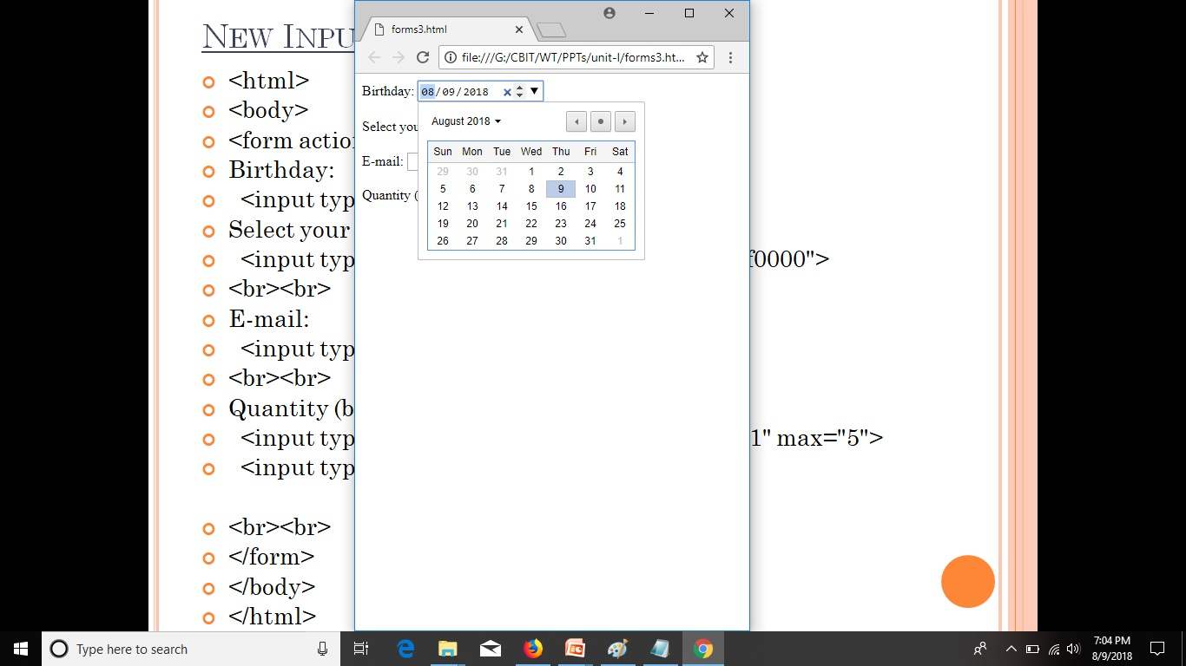
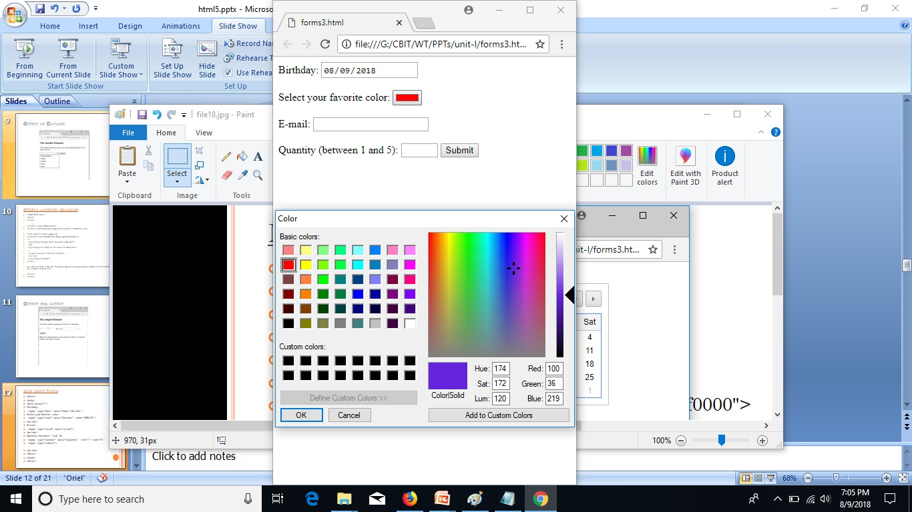
NEW INPUT TYPES

Slide 43
HTML Forms
<!DOCTYPE html>
<html>
<body>
<h2>HTML Forms</h2>
<form action="/action_page.php" method="get">
First name:<br>
<input type="text" name="firstname" value="Mickey"><br>
Last name:<br>
<input type="text" name="lastname" value="Mouse"><br>
User password:<br>
<input type="password" name="psw"> <br>

Slide 44
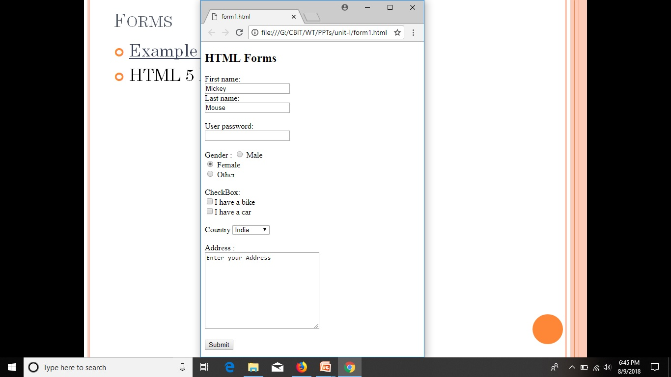
HTML Forms
Gender :
<input type="radio" name="gender" value="male"> Male<br>
<input type="radio" name="gender" value="female" checked> Female<br>
<input type="radio" name="gender" value="other"> Other<br><br>
CheckBox:<br>
<input type="checkbox" name="vehicle1" value="Bike">I have a bike<br>
<input type="checkbox" name="vehicle2" value="Car">I have a car <br>
Country
<select name="country">
<option value="India">India</option>
<option value="Australia">Australia</option>
<option value="USA">USA</option>
<option value="Canada">Canada</option>
</select> <br><br>
Address :<br>
<textarea name="message" rows="10" cols="30">
Enter your Address
</textarea><br><br>
<input type="submit" value="Submit">
</form>
</body>
</html>

Slide 45
HTML Canvas
The HTML <canvas> element is used to draw graphics via JavaScript.
The <canvas> element is only a container for graphics.
Canvas has several methods for drawing paths, boxes, circles, text, and adding images.
A canvas is a rectangular area on an HTML page.
By default, a canvas has no border and no content.
<canvas id="myCanvas" width="200" height="100"></canvas>

Slide 46
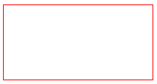
HTML Canvas
<!DOCTYPE html>
<html>
<body>
<canvas
id="myCanvas" width="200" height="100" style="border:1px solid red;">
</canvas>
</body>
</html>
---🡪 A rectangle will be displayed in the output

Slide 47
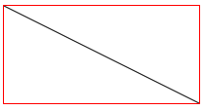
HTML Canvas
<!DOCTYPE html>
<html>
<body>
<canvas id="myCanvas" width="200" height="100" style="border:1px solid red;">
<script>
var c = document.getElementById("myCanvas");
var ctx = c.getContext("2d");
ctx.moveTo(0,0);
ctx.lineTo(200,100);
ctx.stroke();
</script>
</body>
</html>

Slide 48
What is SVG?
SVG stands for Scalable Vector Graphics
SVG is used to define graphics for the Web
SVG is a W3C recommendation
The HTML <svg> element is a container for SVG graphics.
SVG has several methods for drawing paths, boxes, circles, text, and graphic images.

Slide 49

What is SVG?
<!DOCTYPE html>
<html>
<body>
<svg width="100" height="100">
<circle cx="50" cy="50" r="40"
stroke="green"
stroke-width="4"
fill="yellow" />
</svg>
</body>
</html>

Slide 50
HTML <span> Tag
A <span> element used to color a part of a text.
The <span> tag is used to group inline-elements in a document.
The <span> tag provides no visual change by itself.
The <span> tag is easily styled by CSS or manipulated with JavaScript using the class or id attribute.
The <span> tag is much like the <div> element, but <div> is a block-level element and <span> is an inline element.

Slide 51
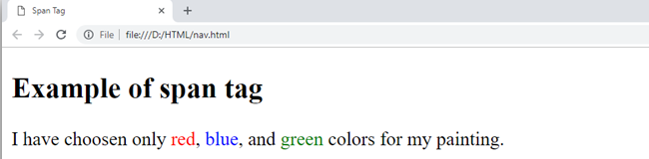
SPAN TAG
<!DOCTYPE html>
<html>
<head>
<title>Span Tag</title>
</head>
<body>
<h2>Example of span tag</h2>
<p>
I have chosen only
<span style="color:red;">red</span>,
<span style="color:blue;">blue</span>, and
<span style="color:green;">green</span>
colors for my painting.
</p>
</body>
</html>

Slide 52
Tag <div>
The <div> tag defines a division or a section in an HTML document.
The <div> element is often used as a container for other HTML elements to style them with CSS or to perform certain tasks with JavaScript.
By default, browsers always place a line break before and after the <div> element.

Slide 53
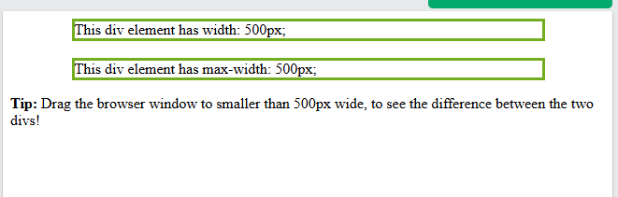
Tag <div>
<!DOCTYPE html>
<html>
<head>
<style>
div.ex1 { width:500px; margin: auto; border: 3px solid #73AD21; }
div.ex2 { max-width:500px; margin: auto; border: 3px solid #73AD21;}
</style>
</head>
<body>
<div class="ex1">This div element has width: 500px;</div><br>
<div class="ex2">This div element has max-width: 500px;</div>
<p><strong>Tip:</strong> Drag the browser window to smaller than 500px wide, to see the difference between the two divs!</p>
</body>
</html>

Slide 54
What is Multimedia?
Multimedia comes in many different formats. It can be almost anything you can hear or see.
Examples: Images, music, sound, videos, records, films, animations, and more.
Multimedia Formats
Multimedia elements (like audio or video) are stored in media files.
Multimedia files have formats and different extensions like: .swf, .wav, .mp3, .mp4, .mpg, .wmv, and .avi.

Slide 55


What is Multimedia?
Playing Videos in HTML
<video width="320" height="240" controls>
<source src="file_example_MP4_480_1_5MG" type="video/mp4">
</video>
Playing audios in HTML
<audio controls>
<source src="horse.ogg" type="audio/ogg">
</audio>

Slide 56
<iframe> in HTML
The iframe in HTML stands for Inline Frame.
The ” iframe ” tag defines a rectangular region within the document in which the browser can display a separate document, including scrollbars and borders.
An inline frame is used to embed another document within the current HTML document.
The ‘ src ‘ attribute is used to specify the URL of the document that occupies the iframe.
<iframe src="URL"></iframe>

Slide 57
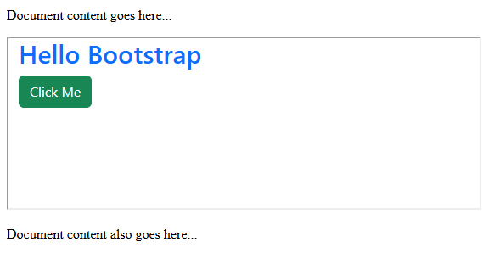
<iframe> in HTML
<!DOCTYPE html>
<html>
<head>
<title>HTML Iframes</title>
</head>
<body>
<p>Document content goes here...</p>
<iframe src = "C:\Users\CBIT\Desktop\INDEX.html" width = "555" height = "200"> </iframe>
<p>Document content also go here...</p>
</body>
</html>

Slide 58
HTML YouTube Videos
<!DOCTYPE html>
<html>
<body>
<iframe width="420" height="345" src=" https://youtu.be/rzjgMKTPlis "> </iframe>
</body>
</html>

Slide 59
What is CSS?
CSS stands for Cascading Style Sheets.
CSS describes how HTML elements are to be displayed on screen or in other media.
CSS saves a lot of work. It can control the layout of multiple web pages all at once.
External style sheets are stored in CSS files.

Slide 60
CSS SELECTORS
Element Selector
ID Selector
Class Selector
Group Selector
Universal Selector

Slide 61
CSS Selectors
CSS selectors are used to "find" HTML elements based on their element name, id, class, attribute, and more.
The element Selector
The element selector selects elements based on the element name.
You can select all <p> elements on a page.
In this case, all <p> elements will be center-aligned, with a red text color.

Slide 62
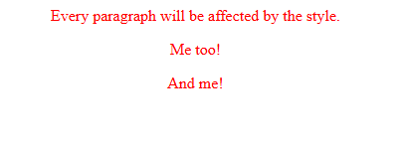
Element Selector
<!DOCTYPE html>
<html>
<head>
<style>
p
{
text-align: center;
color: red;
}
</style>
</head>
<body>
<p>Every paragraph will be affected by the style.</p>
<p id="para1">Me too!</p>
<p>And me!</p>
</body>
</html>

Slide 63
The Id Selector
The id selector uses the id attribute of an HTML element to select a specific element.
The id of an element should be unique within a page, so the id selector is used to select one unique element!
To select an element with a specific id, write a hash (#) character, followed by the id of the element.

Slide 64
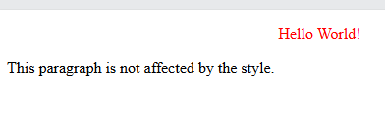
The Id Selector
<!DOCTYPE html>
<html>
<head>
<style>
#para1
{
text-align: center;
color: red;
}
</style>
</head>
<body>
<p id="para1">Hello World!</p>
<p>This paragraph is not affected by the style.</p>
</body>
</html>

Slide 65

The Class Selector
The class selector selects elements with a specific class attribute.
To select elements with a specific class, write a period (.) character, followed by the name of the class.

Slide 66
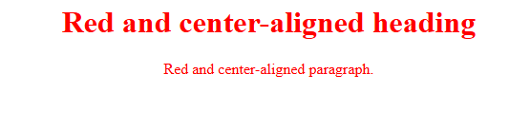
The Class Selector
<!DOCTYPE html>
<html>
<head>
<style>
.center
{
text-align: center;
color: red;
}
</style>
</head>
<body>
<h1 class="center">Red and center-aligned heading</h1>
<p class="center">Red and center-aligned paragraph.</p>
</body>
</html>

Slide 67
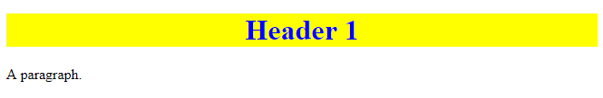
The Class Selector
<!DOCTYPE html>
<html>
<head>
<style>
.intro
{
color: blue;
text-align: center;
}
.important
{
background-color: yellow;
}
</style>
</head>
<body>
<h1 class="intro important">Header 1</h1>
<p>A paragraph.</p>
</body>
</html>

Slide 68
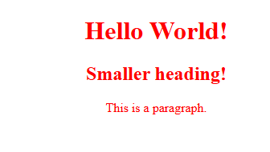
Group Selectors
<!DOCTYPE html>
<html>
<head>
<style>
h1, h2, p
{
text-align: center;
color: red;
}
</style>
</head>
<body>
<h1>Hello World!</h1>
<h2>Smaller heading!</h2>
<p>This is a paragraph.</p>
</body>
</html>

Slide 69
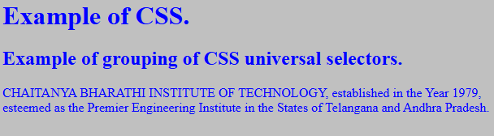
Universal Selectors
<html>
<head>
<title>Simple Example of CSS universal selectors </title>
<style>
*
{
color: blue;
background: silver;
}
</style>
</head>
<body>
<h1>Example of CSS.</h2>
<h2>Example of grouping of CSS universal selectors.</h2>
<p>CHAITANYA BHARATHI INSTITUTE OF TECHNOLOGY, established in the Year 1979, esteemed as the Premier Engineering Institute in the States of Telangana and Andhra Pradesh.</p>
</body>
</html>

Slide 70
Cascading Style Sheets
There are three ways of inserting a style sheet:
External style sheet
Internal style sheet
Inline style

Slide 71
External Style Sheet
With an external style sheet, you can change the look of an entire website by changing just one file!
Each page must include a reference to the external style sheet file inside the <link> element.
The style sheet file must be saved with a .css extension.
<link rel=“stylesheet” type=“text/css” href=“cbitexternal.css”>

Slide 72

External Style Sheet
<!DOCTYPE html>
<html>
<head>
<link rel="stylesheet" type="text/css” href=“cbitexternal.css">
</head>
<body>
<h1>This is a heading</h1>
<p>This is a paragraph.</p>
</body>
</html>

Slide 73
"cbitexternal.css"
body
{ background-color: lightblue; }
h1
{ color: navy; margin-left: 20px; }

Slide 74
Internal Style Sheet
An internal style sheet may be used if one single page has a unique style.
Internal styles are defined within the <style> element, inside the <head> section of an HTML page.
<head>
<style>
Selector
{
property: value
}
</style>
</head>

Slide 75
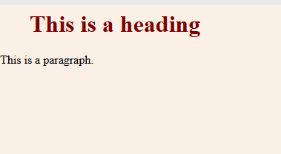
Internal Style Sheet
<html>
<head>
<style>
body
{
background-color: linen;
}
h1
{
color: maroon;
margin-left: 40px;
}
</style>
</head>
<body>
<h1>This is a heading</h1>
<p>This is a paragraph.</p>
</body>
</html>

Slide 76
Inline Styles
An inline style may be used to apply a unique style for a single element.
To use inline styles, add the style attribute to the relevant element. The style attribute can contain any CSS property.
<tag style=“property:value>content</tag>

Slide 77
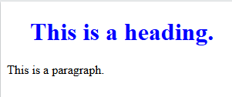
Inline Styles
<!DOCTYPE html>
<html>
<body>
<h1 style="color:blue;margin-left:30px;">This is a heading.</h1>
<p>This is a paragraph.</p>
</body>
</html>

Slide 78
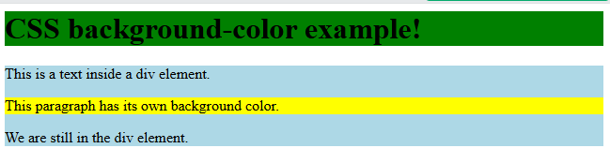
CSS Background Color
<html>
<head>
<style>
h1
{
background-color: green;
}
div
{
background-color: lightblue;
}
p
{
background-color: yellow;
}
</style>
</head>
<body>
<h1>CSS background-color example!</h1>
<div>
This is a text inside a div element.
<p>This paragraph has its own background color.</p>
We are still in the div element.
</div>
</body>
</html>

Slide 79

CSS Background Image
<html>
<head>
<style>
body
{
background-image: url("delighted.webp");
}
</style>
</head>
<body>
<h1>Hello World!</h1>
<p>This page has an image as the background!</p>
</body>
</html>

Slide 80
CSS Background
background-color
background-image
background-repeat
background-attachment
background-position

Slide 81
The CSS Box Model
All HTML elements can be considered as boxes. In CSS, the term "box model" is used when talking about design and layout.
The CSS box model is essentially a box that wraps around every HTML element.
Each Rectangular Box contains 4 edges.
Content Edge
Padding Edge
Border Edge
Margin Edge

Slide 82
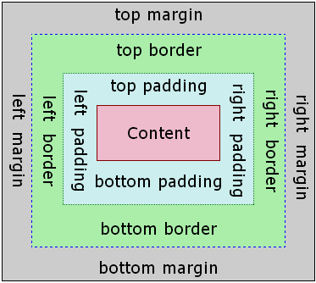
The CSS Box Model

Slide 83
The CSS Box Model
Content - The content of the box, where text and images appear.
Padding - Clears an area around the content. The padding is transparent.
Border - A border that goes around the padding and content.
Margin - Clears an area outside the border. The margin is transparent.

Slide 84
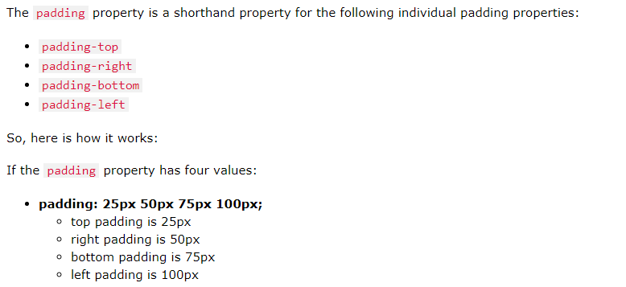




The CSS Box Model

Slide 85
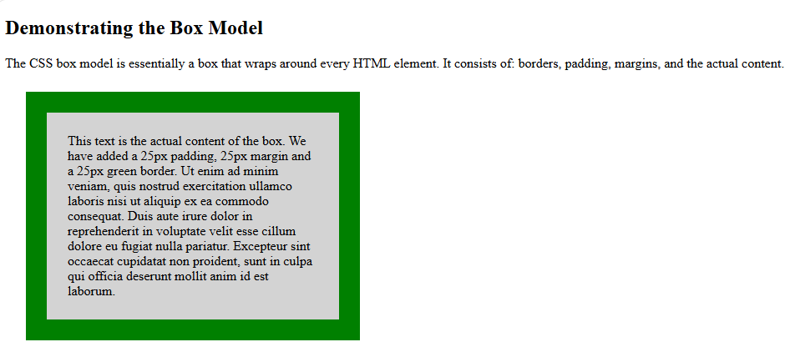
The CSS Box Model
<!DOCTYPE html>
<html>
<head>
<style>
div
{
background-color: lightgrey;
width: 300px;
border: 25px solid green;
padding: 25px;
margin: 25px;
}
</style>
</head>
<body>
<h2>Demonstrating the Box Model</h2>
<p>The CSS box model is essentially a box that wraps around every HTML element. It consists of: borders, padding, margins, and the actual content.</p>
<div>This text is the actual content of the box. We have added a 25px padding, 25px margin and a 25px green border. Ut enim ad minim veniam, quis nostrud exercitation ullamco laboris nisi ut aliquip ex ea commodo consequat. Duis aute irure dolor in reprehenderit in voluptate velit esse cillum dolore eu fugiat nulla pariatur. Excepteur sint occaecat cupidatat non proident, sunt in culpa qui officia deserunt mollit anim id est laborum.</div>
</body>
</html>

Slide 86
CSS POSITIONING
The CSS position property defines the position of an element where generally the top, right, bottom, and left properties will determine the position of the element.
However, these properties will not work unless the position property is set first. They also work differently depending on the position value.
position: value;

Slide 87
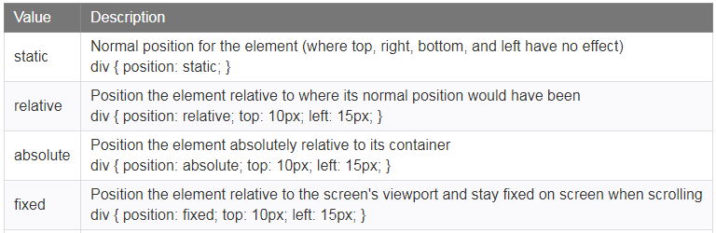
CSS POSITIONING

Slide 88
STATIC POSITION
position: static;
HTML elements are positioned static by default.
Static positioned elements are not affected by the top, bottom, left, and right properties.
An element with position: static; is not positioned in any special way; it is always positioned according to the normal flow of the page.

Slide 89
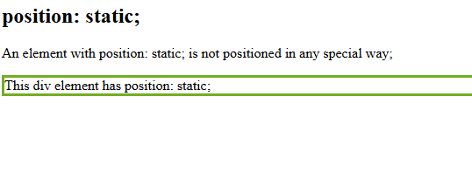
STATIC POSITION
<html>
<head>
<style>
div.static
{
position: static;
border: 3px solid #73AD21;
}
</style>
</head>
<body>
<h2>position: static;</h2>
<p>An element with position: static; is not positioned in any special way;</p>
<div class="static"> This div element has position: static; </div>
</body>
</html>

Slide 90
Relative Position
position: relative;
An element with position: relative; is positioned relative to its normal position.
Setting the top, right, bottom, and left properties of a relatively-positioned element will cause it to be adjusted away from its normal position.
Other content will not be adjusted to fit into any gap left by the element.

Slide 91
FIXED POSITION
position: fixed;
An element with position: fixed; is positioned relative to the viewport, which means it always stays in the same place even if the page is scrolled. The top, right, bottom, and left properties are used to position the element.
A fixed element does not leave a gap in the page where it would normally have been located.

Slide 92
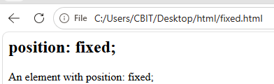
FIXED POSITION
<html>
<head>
<style>
div.fixed
{
position: fixed;
bottom: 0;
right: 0;
width: 300px;
border: 3px solid #73AD21;
}
</style>
</head>
<body>
<h2>position: fixed;</h2>
<p>An element with position: fixed;</p>
<div class="fixed">
This div element has position: fixed;
</div>
</body>
</html>

Slide 93
ABSOLUTE POSITION
position: absolute;
Elements with position: absolute; are positioned relative to their parent elements.
That means that the parent element has to have a position value other than position: static.
However; if an absolute positioned element has no positioned ancestors, it uses the document body, and moves along with page scrolling.

Slide 94
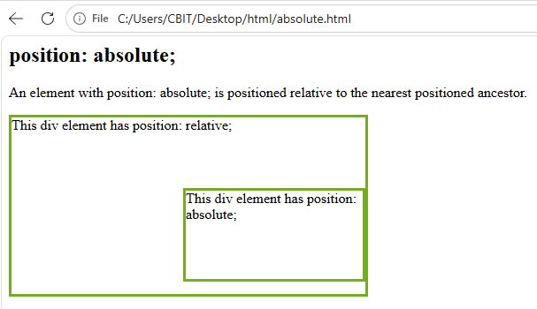
ABSOLUTE POSITION
<html>
<head>
<style>
div.relative { position: relative; width: 400px; height: 200px; border: 3px solid #73AD21;}
div.absolute { position: absolute; top: 80px; right: 0; width: 200px; height: 100px; border: 3px solid #73AD21;}
</style>
</head>
<body>
<h2>position: absolute;</h2>
<p>An element with position: absolute; is positioned relative to the nearest positioned ancestor.</p>
<div class="relative">This div element has position: relative;
<div class="absolute">This div element has position: absolute;</div>
</div>
</body>
</html>

Slide 95
CSS Layout - Float and Clear
The float property specifies whether or not an element should float.
The clear property is used to control the behavior of floating elements.
The float property can be used to wrap text around images.

Slide 96
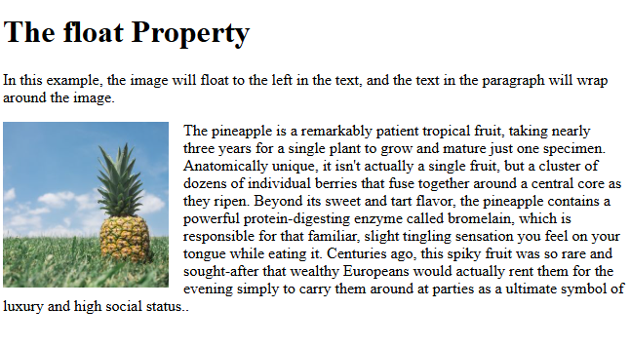
CSS Layout - Float and Clear

Slide 97
CSS Layout - Float and Clear
The clear property is used to control the behavior of floating elements.
Elements after a floating element will flow around it. To avoid this, use the clear property.
The clear property specifies on which sides of an element floating elements are not allowed to float.

Slide 98
CSS Grid Layout
The CSS Grid Layout Module offers a grid-based layout system, with rows and columns, making it easier to design web pages without having to use floats and positioning.
Display property is set to grid or inline-grid.
The gap property is a shorthand property for the row-gap and the column-gap properties.

Slide 99


CSS Grid Layout

Slide 100
CSS Grid Layout
.grid-container
{
display: inline-grid;
grid-template-columns: auto auto auto;
background-color: #2196F3;
padding: 10px;
}
.grid-item
{
background-color: rgb(255, 255, 255);
border: 1px solid rgb(0, 0, 0);
padding: 20px;
font-size: 30px;
text-align: center;
}

Slide 101

CSS Grid Layout
<div class="grid-container">
<div class="grid-item">1</div>
<div class="grid-item">2</div>
<div class="grid-item">3</div>
<div class="grid-item">4</div>
<div class="grid-item">5</div>
<div class="grid-item">6</div>
<div class="grid-item">7</div>
<div class="grid-item">8</div>
<div class="grid-item">9</div>
</div>

Slide 102


CSS Based CHESS Board & VIBGYOR
https://docs.google.com/presentation/d/1shvgm6WNHKDxSu6zxGrOaCt-4k70OuBa/edit#slide=id.p2

